Slide 1
Azure Integration Overview
Pawan Shukla

Slide 2
Agenda
Service Bus
Queues
Topics
Relays
Event Hubs
Traffic Manager
Hybrid Connections

Slide 3
Azure Service Bus
Notes:
Now let’s focus on Microsoft Azure Service Bus the PaaS service!

Slide 4

Microsoft Azure Service Bus
A cloud-based communication and messaging offering
Queues
Topics
Relays
Event Hubs

Slide 5
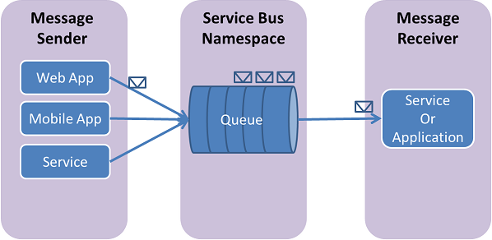
Queue
Brokered Messaging
Shared cursors and locks over the Message Log
Competing Consumers
Charged by number of operations and connections

Slide 6
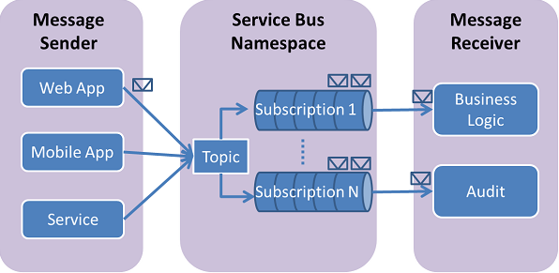
Topic
Brokered Messaging
Multiple subscribers with own cur/locks
Can also filter based on properties
Charged by number of operations and connections

Slide 7
Demo: Queue and Topic

Slide 8
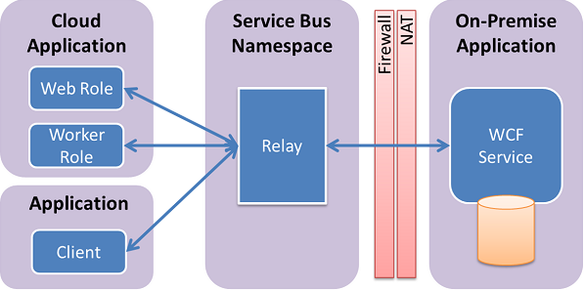
Relay
Relayed Messaging
Integrated w/ WCF programming model
No open inbound firewall/NAT ports
Charged by number of ‘relay hours’

Slide 9
Demo: Relay

Slide 10
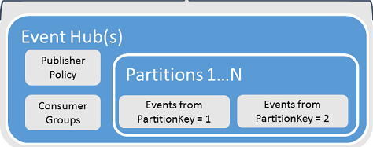
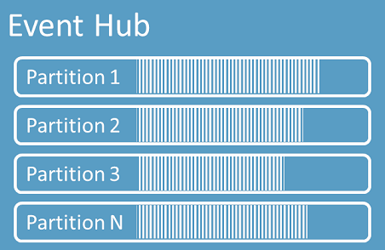
Event Hub
Event Processing Service
Low latency, high reliability
Partitioned Consumers
AMQP and HTTP

Slide 11
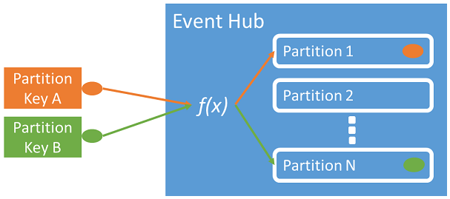
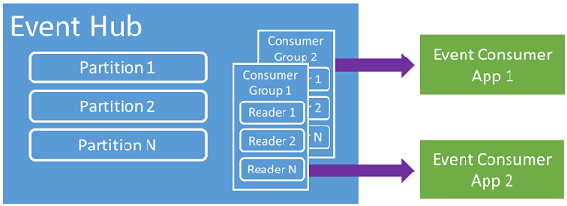
Event Hub
Publisher Tasks
Acquire a SAS token
Publish an event
Consumer Tasks
Connect to a partition
Read events

Slide 12
Architecture
Starting with the basics

Slide 13
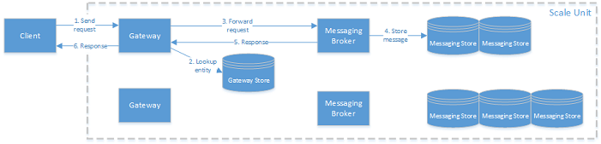
Brokered Messaging
Notes:
When a client sends a request to Service Bus, the Azure load balancer routes it to any of the gateway nodes. The gateway node authorizes the request. If the request concerns a messaging entity (queue, topic, subscription), the gateway node looks up the entity in the gateway store and determines in which messaging store the entity is located. It then looks up which messaging broker node is currently servicing this container, and sends the request to that messaging broker node. The messaging broker node processes the request and updates the entity state in the container store. The messaging broker node then sends the response back to the gateway node, which sends an appropriate response back to the client that issued the original request.

Slide 14
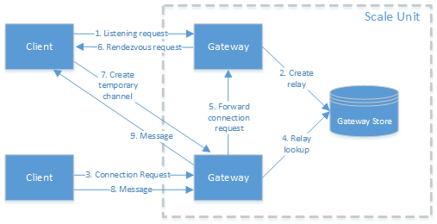
Relay Messaging
Notes:
When a client sends a request to Service Bus, the Azure load balancer routes it to any of the gateway nodes. If the request is a listening request, the gateway node creates a new relay. If the request is a connection request to a specific relay, the gateway node forwards the connection request to the gateway node that owns the relay. The gateway node that owns the relay sends a rendezvous request to the listening client, asking the listener to create a temporary channel to the gateway node that received the connection request.
When the relay connection is established, the clients can exchange messages via the gateway node that is used for the rendezvous.

Slide 15

Azure Traffic Manager

Slide 16
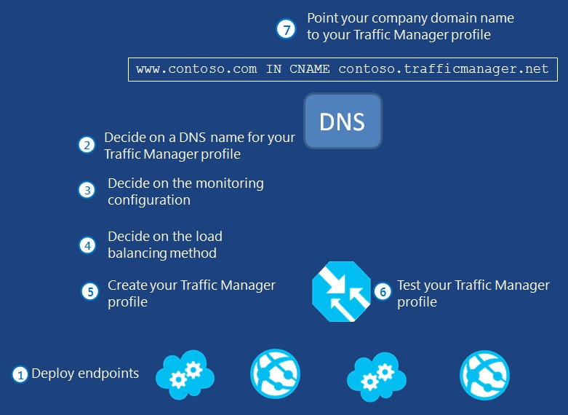
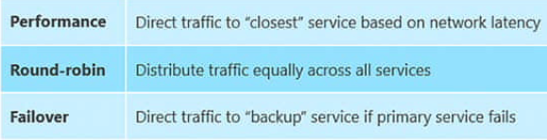
Azure Traffic Manager
Build high performing cloud apps
Plan for disaster recovery
Upgrade Cloud Applications seamlessly
Notes:
Load balance incoming traffic across multiple Azure hosted services to deliver high performance, availability and resilience for your applications

Slide 17
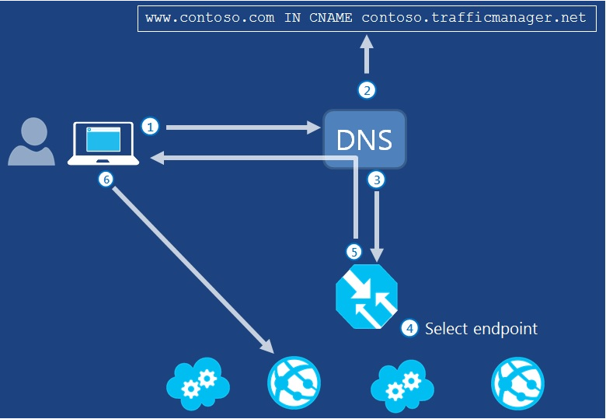
Azure Traffic Manager

Slide 18
Demo: Traffic Manager

Slide 19
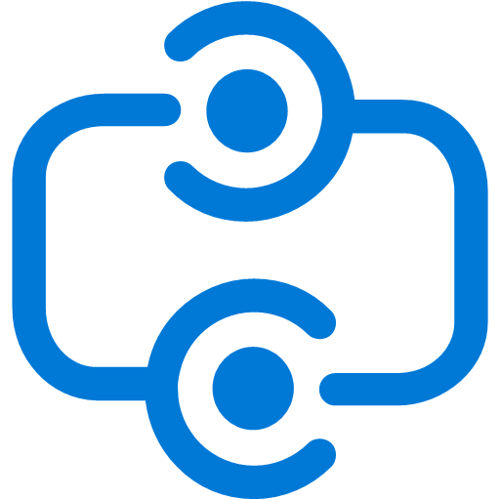
Hybrid Connections

Slide 20
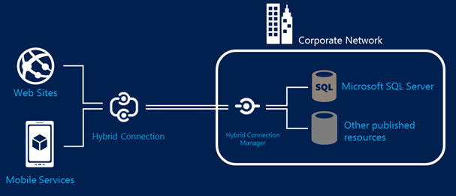
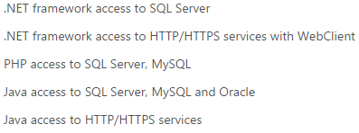
Hybrid Connections
Connect Azure apps to On-Premise resources
Uses SAS to secure connections. Requires open outbound ports
Install Hybrid Connection Manager on-premise
Notes:
Scenarios where I would I use Hybrid Connections
I think that the following list of items would be scenarios where Hybrid Connections are likely to be a better choice:
The client is hosted inside of Azure
You want to integrate directly with a resource, which is not hosted in WCF. Eg: you want to connect directly to a database
The client wanting to connect to the resource is not able to talk WCF and perhaps isn’t even a Microsoft technology
You want to create a point to point tightly coupled connection from a cloud resource to an on premise resource
I am already using Hybrid Connections in my architecture and the integration pattern matches the patterns I already use it for
Scenarios where I would I use Service Bus Relay
I think the following list of items would be things would be scenarios of requirements, which would indicate service bus relay would be the only choice you could use:
The client is hosted outside of Azure
The client is hosted on a resource in Azure which is not supported by Hybrid Connections (see documentation for more info)
You want to connect your WCF service directly to the cloud rather than having an on-premise man in the middle style agent installed
I am already using Service Bus Relay in my architecture and the integration pattern matches the patterns I already use it for

Slide 21
Q&A

Slide 22


Get started
Visit azure.microsoft.com

Slide 23
Hands-On Labs https://github.com//AzureDevCamp.git

